Slide 1

Travel Package Market Analysis Web Scraping & Exploratory Data Analysis of TravelTriangle.com
Sakshith

Slide 2
Agenda
Business Problem & Objective
Data Source & Web Scraping
Data Understanding & Cleaning
Exploratory Data Analysis — 6 Business Questions
Statistical Testing (Correlation, ANOVA, t-test, Chi-square)
Business Insights
Conclusion
Sakshith | TravelTriangle Package Analysis
2

Slide 3
Business Problem & Objective
Travel package pricing on TravelTriangle is scattered across hundreds of listings covering destination, duration, hotel rating, and discounts. Travelers and analysts have no easy way to compare packages or spot pricing patterns, making it hard to identify value-for-money options or understand what actually drives price
The project aims to analyze scraped TravelTriangle package data to identify pricing patterns, destination trends, package value, and factors associated with package prices.
Objective
Scrape package-level listings from traveltriangle.com across 60 pages
Clean the data and engineer features (Price/Day, Price Category, Trip Length)
Answer 6 business questions on destination popularity, pricing & value
Validate patterns statistically (correlation, ANOVA, t-test, chi-square)
Sakshith | TravelTriangle Package Analysis
3

Slide 4
Data Source & Web Scraping
Workflow
Fields Collected
traveltriangle.com/tour-packages/india
Requests + BeautifulSoup
Loop through 60 pages
Parse each package card
Structured dataset (CSV)
Package Name & Destination
Days / Nights
Current Price & Old Price
Discount (%)
Hotel Rating
Cities Covered
880
packages scraped across 60 pages, 9 raw fields each
Sakshith | TravelTriangle Package Analysis
4

Slide 5
Data Understanding & Cleaning
Cleaning Steps
Missing values (Old Price: 1, Discount: 1, Hotel Rating: 2) filled with median
Checked for duplicate records — none found
Standardized Destination, Cities Covered & Package Name text
IQR outlier check on Price, Discount, Days — retained as genuine variation
880 rows
9 raw features → 14 engineered features
0
duplicate records
4
columns had missing values — all resolved via median imputation
Feature Engineering
Price Difference = Old Price − Current Price
Price Per Day = Current Price / Days
Number of Cities, Price Category, Trip Length
Sakshith | TravelTriangle Package Analysis
5

Slide 6
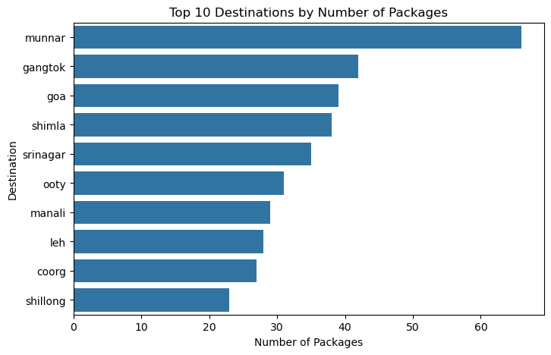
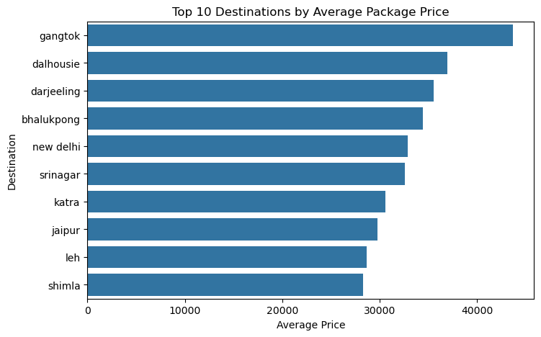
1. Which destinations have the highest package availability on TravelTriangle? Which destinations are the most expensive?
Q1: Package Availability by Destination
Q2: Most Expensive Destinations (Avg. Price)
Key Insights:
1.The analysis shows that [munnar] has the highest number of packages, followed by [gangtok] and [goa]. This indicates that these destinations have a strong presence in TravelTriangle's package offerings.
2.[gangtok] has the highest average package price among destinations with sufficient package representation.
Sakshith | TravelTriangle Package Analysis
6

Slide 7
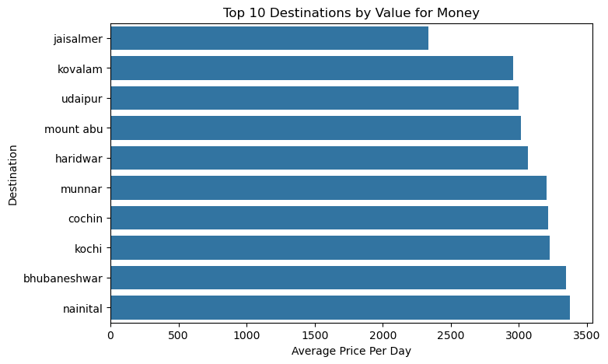
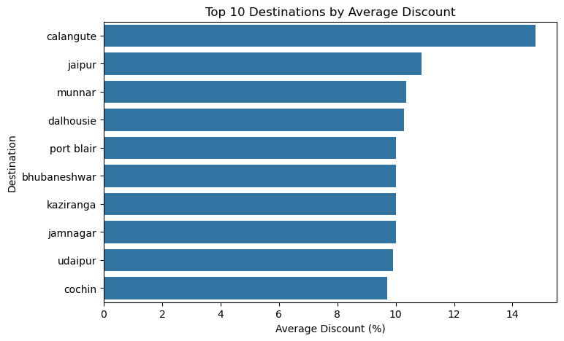
2. Which destinations provide the best value for money?
Q3: Lowest Price-per-Day by Destination
Q6: Highest Average Discounts by Destination
Interpretation:
[jaisalmer] has the lowest average price per day, indicating that travelers can potentially obtain a lower daily package cost compared with other destinations.
Sakshith | TravelTriangle Package Analysis
7

Slide 8
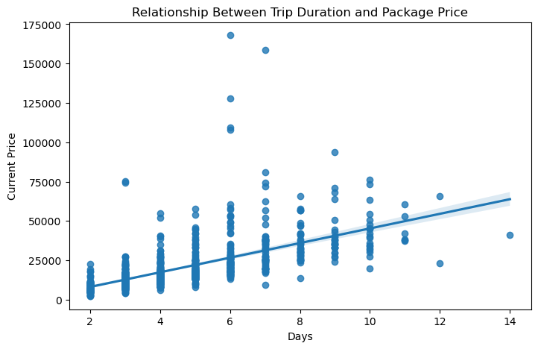
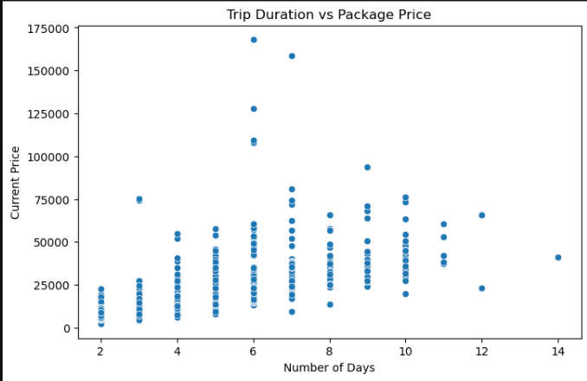
3. Does trip duration affect package price?
Q4: Trip Duration vs Package Price
Q5: Package Price by Hotel Rating
The correlation between trip duration and package price is [0.6104717401669288], indicating a [weak/moderate/strong] positive relationship. The p-value is [5.528400685314052e-9]. Since the p-value is [greater] than 0.05, the relationship is [not statistically significant].
Sakshith | TravelTriangle Package Analysis
8

Slide 9
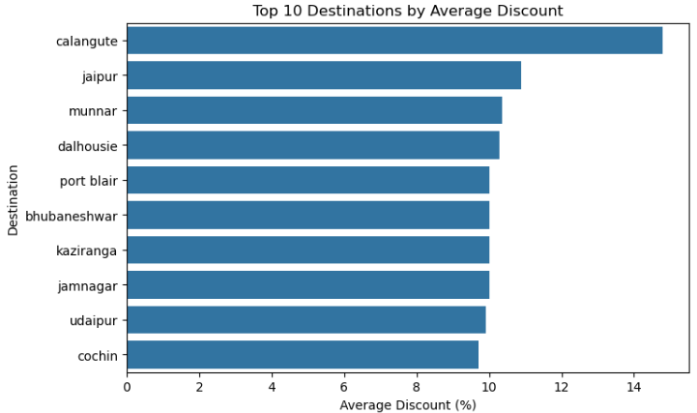
4. Which destinations offer the highest discounts?
Interpretation:
[calanguate] has the highest average discount among destinations with sufficient package representation.with other destinations.
Sakshith | TravelTriangle Package Analysis
7

Slide 10
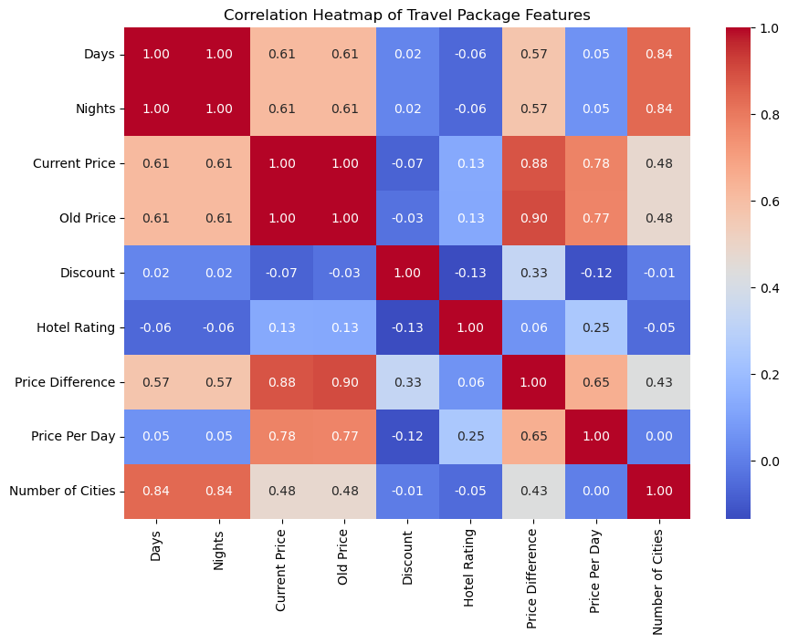
5.Correlation Heatmap & Statistical Tests
Pearson Correlation — Duration vs Price
r = 0.61, p < 0.001 — Significant positive relationship
ANOVA — Price across Hotel Ratings
F = 16.70, p < 0.001 — Significant price differences
Independent t-test — 3★ vs 4★ Price
t = -2.30, p = 0.023 — Significant price difference
Chi-square — Hotel Rating × Price Category
χ² = 16.96, p = 0.009 — Significant association
Sakshith | TravelTriangle Package Analysis
9

Slide 11
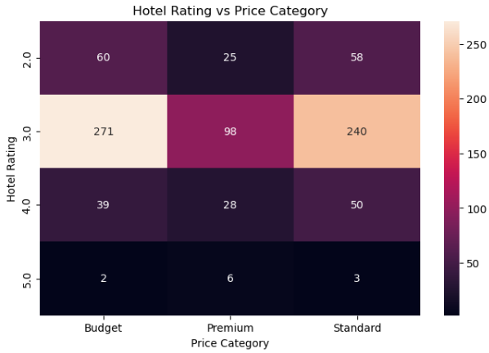
6.Chi-Square Test:
Is hotel rating associated with package price category?
Hypotheses
H₀: Hotel rating and price category are independent.
H₁: Hotel rating and price category are associated.
Interpretation :
p-value < 0.05
Reject H₀. There is statistically significant evidence of an association between hotel rating and package price category.
8

Slide 12
Business Insights
Munnar, Gangtok, and Goa dominate package availability, showing strong market saturation at these destinations.
Gangtok, Dalhousie, and Darjeeling command the highest average prices; Jaisalmer, Kovalam, and Udaipur offer the best value per day.
Trip duration is a strong, statistically significant driver of price (r = 0.61, p < 0.001) — longer trips cost more.
Hotel rating significantly affects price (ANOVA p < 0.001) and price category (χ² p = 0.009); 5★ packages average ~₹50,600 — far above other ratings.
Calangute and Jaipur offer the steepest average discounts, useful for budget-conscious travel planning.
Sakshith | TravelTriangle Package Analysis
10

Slide 13
Conclusion
This project scraped and analyzed 880 travel packages from TravelTriangle across 60 pages using Python, Requests, and BeautifulSoup. After cleaning the data and engineering features such as Price Per Day and Price Category, exploratory data analysis and statistical testing — Pearson correlation, ANOVA, t-test, and chi-square — answered 6 business questions on destination popularity, pricing, and value for money.
The analysis shows that trip duration and hotel rating are statistically significant drivers of package price, and highlights Munnar, Gangtok, and Jaisalmer as standout destinations for availability, premium pricing, and value respectively — insights that can guide both travelers and TravelTriangle's own pricing strategy.
Sakshith | TravelTriangle Package Analysis
11

Slide 14

THANK YOU
Sakshith

